Slide 1
Protein Synthesis Review

Slide 2
DNA & RNA

Slide 3
What is DNA replication? Where does it occur in the cell?
WHEN DNA MAKES A COPY OF ITSELF.
IN THE NUCLEUS!

Slide 4
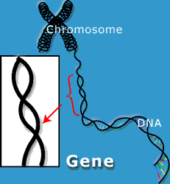
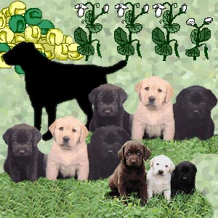
What is the function of genes (segments of DNA)?
GENES ARE A SMALL SECTION OF DNA THAT CODES FOR A PARTICULAR TRAIT.

Slide 5
Name 3 characteristics that all living things have in common.
ALL LIVING THINGS:
ARE MADE UP OF CELLS
RESPOND TO THEIR ENVIRONMENT
REPRODUCE
REQUIRE NUTRIENTS
GROW AND DEVELOP
HAVE DNA

Slide 6
The building blocks (monomers) of both DNA and RNA are what?

Slide 7
Draw a nucleotide of DNA. Draw a nucleotide of RNA.

Slide 8
What are the 3 differences between DNA and RNA?

Slide 9
Protein Synthesis

Slide 10
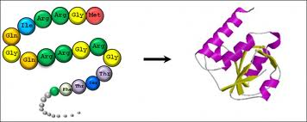
What is another name for a chain of amino acids?
A POLYPEPTIDE OR A PROTEIN!

Slide 11
What is protein synthesis?
THE “READING” OF A GENE IN DNA TO PRODUCE A PROTEIN (POLYPEPTIDE) AT THE RIBOSOME IN THE CYTOPLASM.

Slide 12
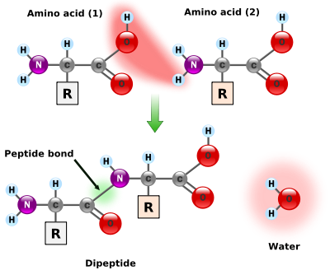
What is the monomer of a protein?
AN AMINO ACID!

Slide 13
What is the pathway for protein synthesis (HINT use the following words tRNA, DNA, Protein, mRNA)

Slide 14
What are the two steps of protein synthesis? It is understood that RNA processing has taken place.

Slide 15
Transcription

Slide 16
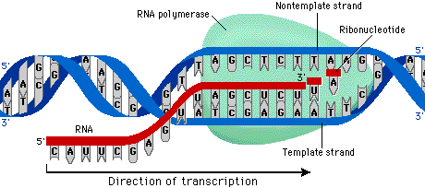
What happens during transcription?
mRNA MAKES A “COPY” OF A SECTION OF DNA (A GENE). THE DIFFERENCE IS THAT “U” IS SUBSTITUTED FOR “T”

Slide 17
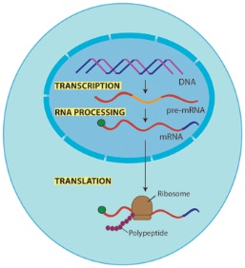
Where in the cell does transcription occur?
NUCLEUS
IN THE NUCLEUS!

Slide 18
. What is the function of mRNA?
mRNA takes the information from the DNA in the nucleus out to the ribosome.
DNA is too large to do it on it’s own. It cannot leave the nucleus.
mRNA sends the “message” for the DNA.

Slide 19
Transcribe the following DNA strand into mRNA : 5’ ATCGAACAG 3’
3’UAGCUUGUC5’

Slide 20
Transcribe the following DNA strand into mRNA: 5’ TACGGGTTA 3’
3’AUGCCCAAU5’

Slide 21
Turn the following mRNA strand back into DNA: 5’AUGCACUAC3’
3’TACGTGATG5’

Slide 22
If RNA polymerase stopped working, what would be the result?
NONE OF THE GENES COULD BE TRANSCRIBED – SO NONE OF THE GENES WOULD BE EXPRESSED.
IT IS GENE EXPRESSION THAT ALLOWS CELLS TO BE SPECIALIZED AFTER DIFFERENTIATION SO…………….
YOUR NAILS WOULD STOP GROWING.
YOUR HAIR WOULD STOP GROWING.
YOU WOULDN’T BE ABLE TO DIGEST FOOD OR MAKE NEW BLOOD CELLS.
YOUR SKIN WOULDN’T BE ABLE TO REPAIR SCRAPES.
YOU COULDN’T BUILD MUSCLE
In other words none of your cells could do their jobs.

Slide 23
Translation

Slide 24
What happens during translation?
DURING TRANSLATION, THE mRNA BRINGS THE CODE OUT TO THE RIBOSOME, WHERE THE CODE IS READ BY tRNA AND THE AMINO ACIDS ARE BONDED TOGETHER IN THE RIGHT ORDER.

Slide 25
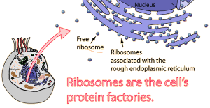
Where in the cell does translation occur?
AT THE RIBOSOME OUT IN THE CYTOPLASM!

Slide 26
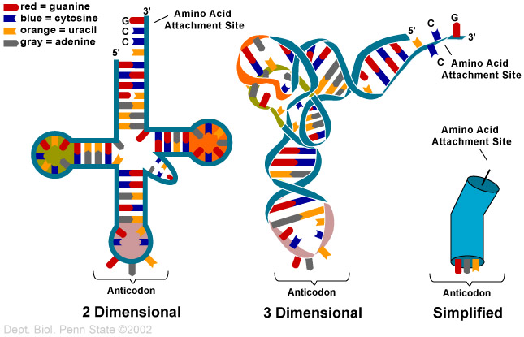
What is the function of tRNA?
TO CONNECT THE RIGHT AMINO ACID TO THE RIGHT CODON DURING TRANSLATION.

Slide 27
What is a codon?
A THREE-LETTER SEGMENT OF RNA THAT CODES FOR A PARTICULAR AMINO ACID.

Slide 28
Translate the following mRNA into a chain of amino acids ACAGUCUAUCUA
THR-VAL-TYR-LEU
GENETIC CODE/CODON CHART

Slide 29
Translate the following mRNA into a chain of amino acids AUGGUUCAAUAA
MET-LEU-GLU-STOP

Slide 30
What would be the next amino acid in this chain?
Histidine

Slide 31
Mutations

Slide 32
What is a mutation?
A CHANGE IN THE SEQUENCE OF DNA NUCLEOTIDES IN A GENE

Slide 33
What are the two general types of mutations?
POINT MUTATION
FRAME-SHIFT MUTATION
CHANGES IN AN INDIVIDUAL GENEDUE TO MISCOPYING ONE OR MORE NUCLEOTIDES
DELETION OR INSESRTION OF A NUCLEOTIDE RESULTS IN SHIFTING OF THE READING FRAME ALL TOGETHER.

Slide 34
What is a point mutation? What is a frameshift mutation?
POINT MUTATION:
FRAME-SHIFT MUTATION
THE CAT ATE THE FAT RAT
THE CAT ATE THE FAT CAT
THE CAT ATE THE FAT RAT
THE CAA TET HEF ATC AT

Slide 35
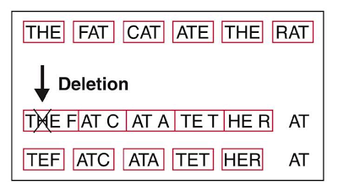
Describe what happens during protein synthesis if a substitution occurs? An insertion? A deletion?

Slide 36
What is wrong in the diagram below?
ONE OF THE STRANDS HAS URACIL WHERE THERE SHOULD BE AN ADENINE.

Slide 37
What do we call what happened here? Phe-Leu-Cys-Trp-STOP changed to Phe-Leu-Phe-Trp-STOP Explain.
A mutation occurred - UUU-UUA-UGU-UGG-UGA) WAS CHANGED TO UUU-UUA-UUU-UGG-UGA
THERE WAS A SUBSTITUTION OF ONE BASE RESULTING IN THE CHANGE OF ONE AMINO ACID.

Slide 38
This illustration is an example of a normal DNA sequence. Draw a strand that would represent a single base change (substitution) in the sequence?
Changing any single base is a substitution.
For instance:
C-A-T-C-A-T-A-A-T

Slide 39
Gene Expression

Slide 40
Cell specialization in eukaryotes can occur because of _________________
GENE EXPRESSION:
CERTAIN GENES ARE SWITCHED ON, WHILE OTHERS ARE LEFT OFF….
FOR EXAMPLE, RATS DON’T USUALLY GROW HUMAN EARS ONTHEIR BACKS….

